Slide 1
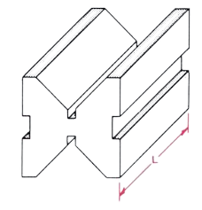
Oblique Projection/ Drawing
Prepared by:
Er. Bibek Magar
BE in Automobile Engineering
IOE, Thapathali Campus
bibek.magar@thc.tu.edu.np

Slide 2
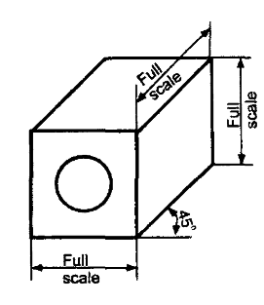
Introduction
Oblique Projection of an object may be obtained by projecting the object with parallel projections that are oblique to the picture plane.
In oblique projection, the front face of the object appears in its true size and shape, as it is placed parallel to the picture plane. The receding lines representing the other two faces are usually drawn at 30°,45° or 60° to the horizontal, 45° being the most common practice.
As in the case of isometric projection, in oblique projection also, all lines that are parallel on the object appear parallel on the drawing and vertical lines on the object appear vertical.

Slide 3
Some general guidelines to approach oblique drawing
After studying the views carefully, select the face that is either the most irregular one or the one with circular features if any. Make that face parallel to the picture plane to minimize distortion.
Draw the face to its true size and shape
Draw the receding lines through all the visible comers of the front face.
Mark the length of the object along the receding lines and join these in the order.
Add other features if any on the top and side faces.

Slide 4
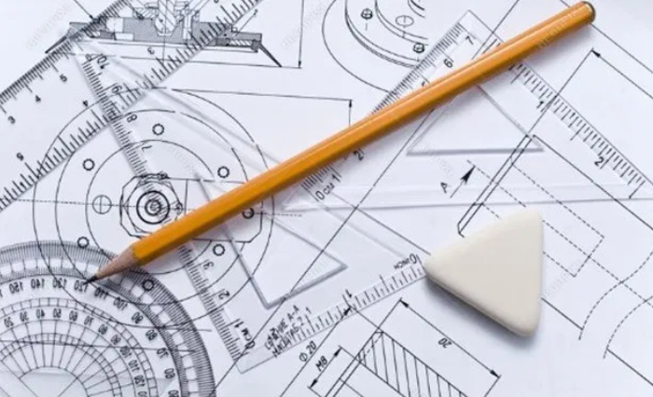
Solved Examples:

Slide 5
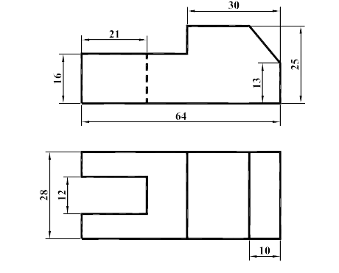
Q1) Draw oblique view of the object from the given orthographic views

Slide 7
Drawing Circles in Oblique View
c
Draw a rhombus with side, which is equal to the given diameter of circle.
m2
Locate mid points for all sides of the rhombus.
c2
c4
Draw a line perpendicular to bc and passing through m2. Similarly draw a line perpendicular to ba and passing through m1. The point of intersection, c1, between these two lines is one of the four centers used for drawing oblique circle.
m3
b
Similarly we can obtain another center, c2, from lines cd and da.
d
The points of intersection, c3 and c4 which also happens to lie in the longer diagonal, between the perpendicular lines drawn earlier are our other two centers required to draw the oblique circle.
m1
c1
c3
m4
Hence, using the four center method we can draw the oblique circle (ellipse).
a

Slide 9
Solved Examples:

Slide 10
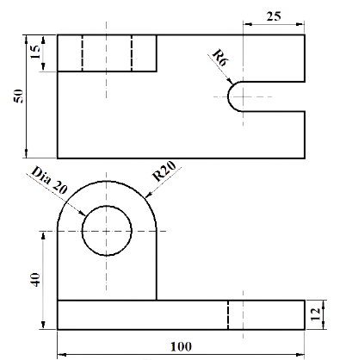
Q2) Draw oblique view of the object from the given orthographic views

Slide 12


